Slide 1


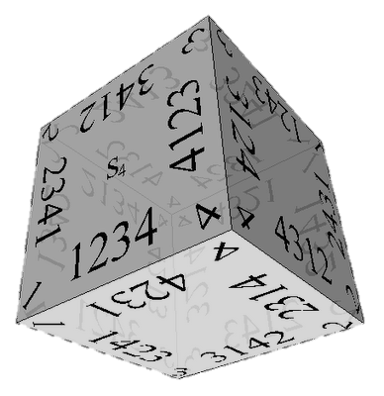

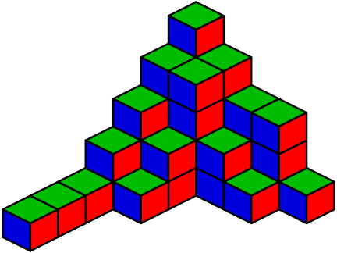

Combinatorial Algorithms
Generating Permutations, Variations, Combinations, …
Combinatorial Algorithms
SoftUni Team
Technical Trainers
Software University
http://softuni.bg

Slide 2
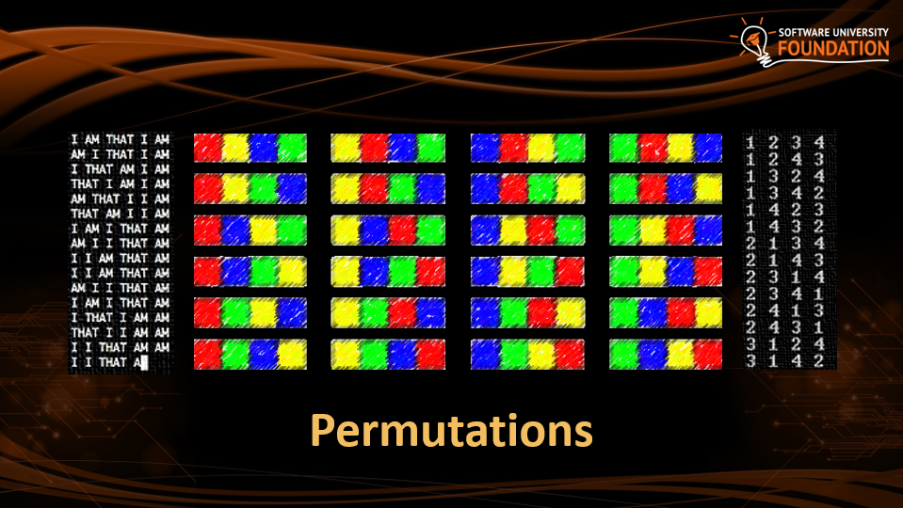
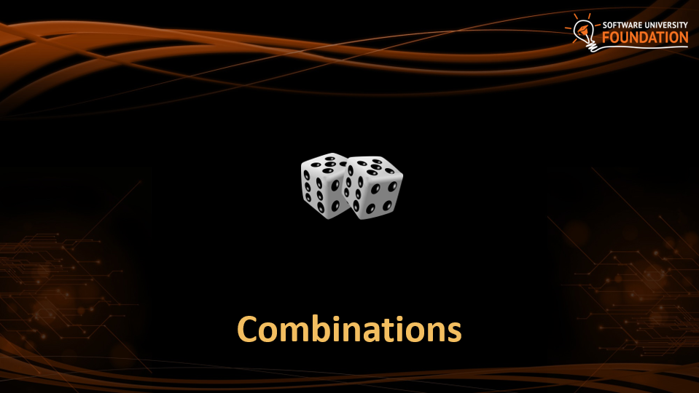

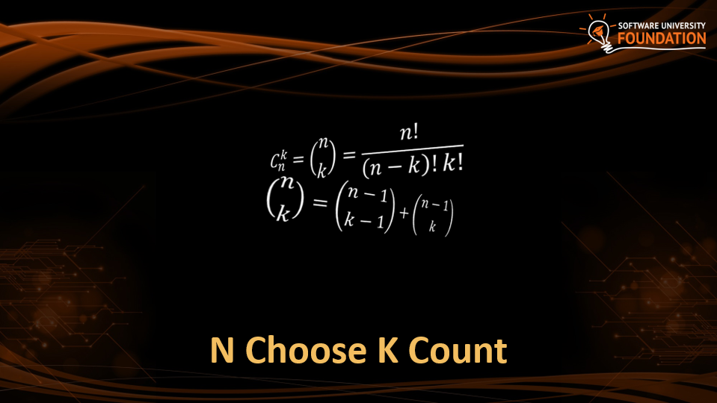
Table of Contents

Slide 3
Have a Question?
sli.do #DsAlgo

Slide 4
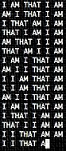
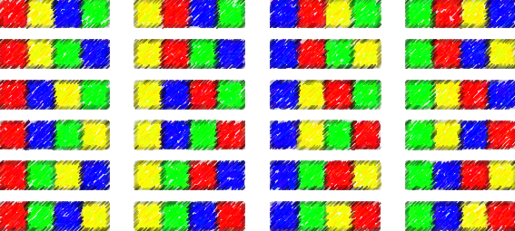
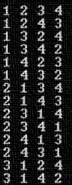
Permutations

Slide 5




Permutations
How to order them in three chairs

Slide 6
Permutations
How to order them in two chairs

Slide 7
Permutations
How to order him in one chairs

Slide 8
Permutations

Slide 9
Permutations
Order A, B and C in all possible ways
A
B
C

Slide 10
Permutations
Order A, B and C in all possible ways
A
B
C
A | B
A | C
B | A
B | C
C | A
C | B

Slide 11
Permutations
Order A, B and C in all possible ways
A
B
C
A | B
A | C
B | A
B | C
C | A
C | B
A | B | C
A | C | B
B | A | C
B | C | A
C | A | B
C | B | A

Slide 12
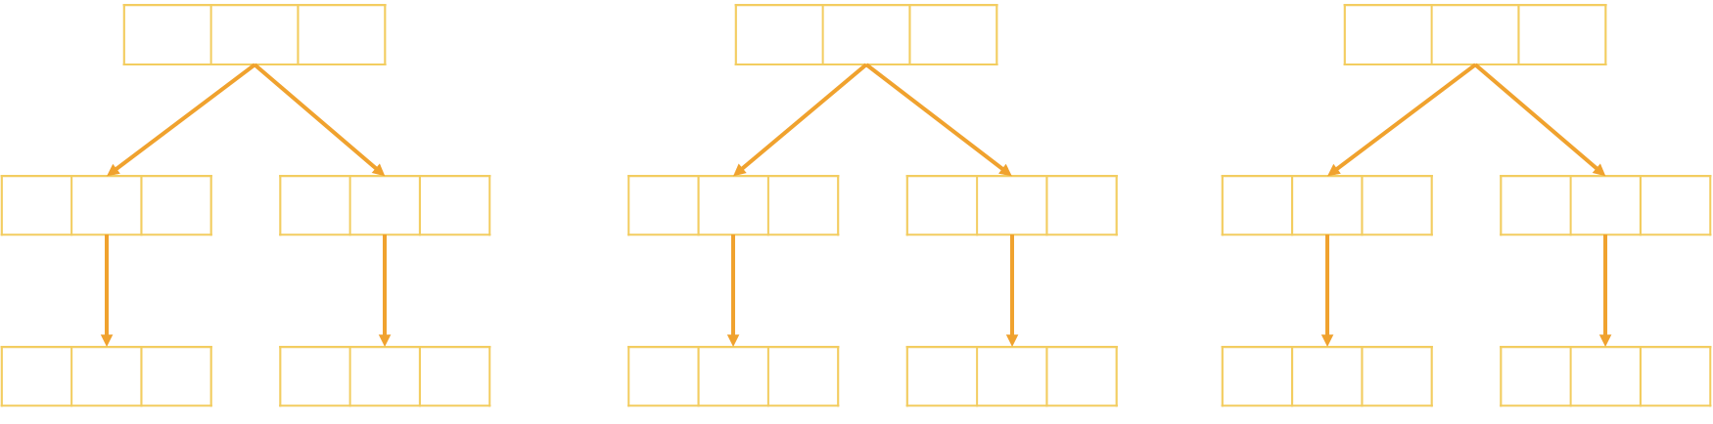
Problem: Generate Permutations
Generates all possible permutations of a given set of elements
You can pick each item only once
A B C
A C B
B A C
B C A
C A B C B A
A B C

Slide 13
Algorithm: Permutations
Algorithm Permute(index) to generate variations P(n)
Put unused elements 0 … n-1 at position index
Mark/unmark elements as being used
Call Permute(index + 1) to generate the rest of the array
Permute(0)
Permute(1)
Permute(k)
Print();
Stop!
0…n-1 | x | x | x | x
→
y | 0…n-1 | x | x | x
…
(unused)
(unused)
Permute(1)
Permute(2)

Slide 14
Generating Permutations
public static void Gen(int index)
{
if (index >= elements.Length)
Console.WriteLine(string.Join(" ", perm));
else
for (int i = 0; i < elements.Length; i++)
if (!used[i])
{
used[i] = true;
perm[index] = elements[i];
Gen(index + 1);
used[i] = false;
}
}
elements = new int[n];
used = new bool[n];
Permute(0);

Slide 15
Permutations Count
Order A, B and C in all possible ways
How many ways are there?
A | B | C
3
2
1
n! = 3!
6 possible ways

Slide 16
Problem: Optimize Permutations
Generates all possible permutations of a given set of elements
Without using extra memory
A B C
A C B
B A C
B C A
C A B C B A
A B C

Slide 17
Permutations: Swap Algorithm

Slide 18
Permutations: Swap Algorithm

Slide 19
Permutations: Swap Algorithm

Slide 20



Permutations: Swap Algorithm

Slide 21
Permutations: Swap Algorithm

Slide 22
Permutations: Swap Algorithm
Swap to origin on the way back

Slide 23
Permutations: Swap Algorithm

Slide 24
Permutations: Swap Algorithm

Slide 25
Permutations: Swap Algorithm
Swap to origin on the way back

Slide 26
Permutations: Swap Algorithm
Swap to origin on the way back

Slide 27
Permutations: Swap Algorithm

Slide 28
Permutations: Swap Algorithm

Slide 29
Permutations: Swap Algorithm

Slide 30
Permutations: Swap Algorithm

Slide 31
Problem: Optimize Permutations
Generates all possible permutations of a given set of elements
Without using extra memory
A B C
A C B
B A C
B C A
C A B C B A
A B C

Slide 32
Generating Permutations
public static void Gen(int index)
if (index >= set.Length)
Console.WriteLine(string.Join(" ", set));
else
Gen(index + 1);
for (int i = index + 1; i < elements.Length; i++)
{
Swap(index, i);
Gen(index + 1);
Swap(index, i);
}
}
elements = new int[n];
Permute(0);

Slide 33
Problem: Permutations with Repetition
What about array = new int[] { A, B, B }
By definition: permutations { A, B', B'' } == { A, B'', B' }
Generate all permutations from a multi-set
A B B
B A B
B B A
A B B

Slide 34
Solution: Permutations with Repetition
public static void Gen(int index)
if (index >= set.Length)
Console.WriteLine(string.Join(" ", set));
else
HashSet<int> swapped = new HashSet<int>();
for (int i = index; i < elements.Length; i++) {
if (swapped.Contains(elements[i])) {
Swap(index, i);
Gen(index + 1);
Swap(index, i);
swapped.Add(elements[i]);
}
}
}
elements = new int[n];
Permute(0);

Slide 35
Optimized: Permutations with Repetition
Algorithm PermRep(s, e) permutes the items [s … e]
Exchange the item at positions l = k … n-2 with items at l … n-1
Call PermRep(l + 1) to permute the rest of the array
PermRep(0, n-1)
PermRep(2, n-1)
PermRep(n-1, n-1)
s
l
s
l
Stop!
→
…
y | x | l | x | x | x
z | y | x | l | x | x
PermRep(l+1, n-1)
PermRep(l+1, n-1)
More info: http://hardprogrammer.blogspot.bg/2006/11/permutaciones-con-repeticin.html

Slide 36
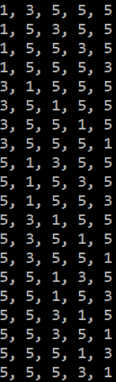
Generating Permutations with Repetition
static void PermuteRep(int[] arr, int start, int end)
{
Print(arr);
for (int left = end - 1; left >= start; left--)
{
for (int right = left + 1; right <= end; right++)
if (arr[left] != arr[right])
{
Swap(ref arr[left], ref arr[right]);
PermuteRep(arr, left + 1, end);
}
var firstElement = arr[left];
for (int i = left; i <= end - 1; i++)
arr[i] = arr[i + 1];
arr[end] = firstElement;
}
}
var arr = new int[] {3, 5, 1, 5, 5};
Array.Sort(arr);
PermuteRep(arr, 0, arr.Length-1);

Slide 37

Permutations with Repetition Count
Order A, B and B in all possible ways
How many ways are there?
A | B | B
$\frac{n!}{s1!s2!..sk!}$ = $\frac{3!}{2!1!}$
3 different ways

Slide 38

Permutations
Live Exercises in Class (Lab)

Slide 39
Variations

Slide 40



Variations
Not enough chairs

Slide 41
Variations

Slide 42


Variations

Slide 43

Variations

Slide 44
Variations

Slide 45
Variations

Slide 46
Variations

Slide 47
Variations

Slide 48
Variations

Slide 49
Variations

Slide 50
Variations
Order A, B and C in all possible ways int k slots
Pick each item only once
A
B
C

Slide 51
Variations
Order A, B and C in all possible ways int k slots
Pick each item only once
A
B
C
A | B
A | C
B | A
B | C
C | A
C | B

Slide 52
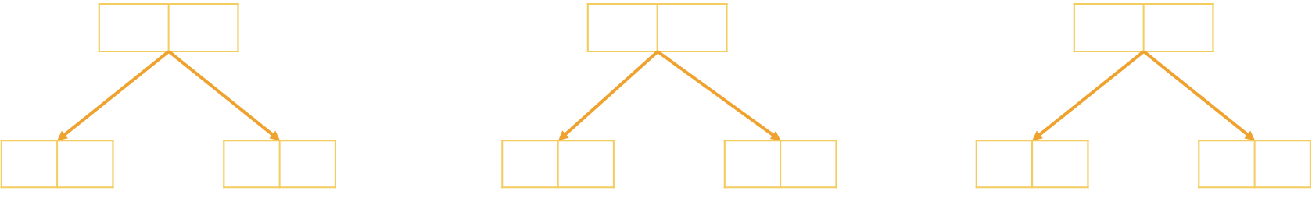
Problem: Generate Variations
Generates all possible variations of k from a set of elements
You can pick an item once
A B
A C
B A
B C
C A
C B
A B C
2

Slide 53
Generating Variations
public static void Gen(int index)
{
if (index >= k)
Console.WriteLine(string.Join(" ", vari));
else
for (int i = 0; i < elements.Length; i++)
if (!used[i])
{
used[i] = true;
vari[index] = elements[i];
Gen(index + 1);
used[i] = false;
}
}
elements = new int[n];
vari = new int[k]
used = new bool[n];
Permute(0);

Slide 54

Variations Count
Order two from A, B, C and D in all possible ways
How many ways are there?
A | B | C | D
4
3
Multiply
$\frac{n!}{(n−k)!}$ = $\frac{4!}{2!}$
12 different ways

Slide 55
Variations with Repetitions
Order A, B and C in all possible ways into k slots
You can pick an item multiple times
A
B
C
A | A
A | B
B | A
B | B
C | A
C | B
A | C
B | C
C | C

Slide 56
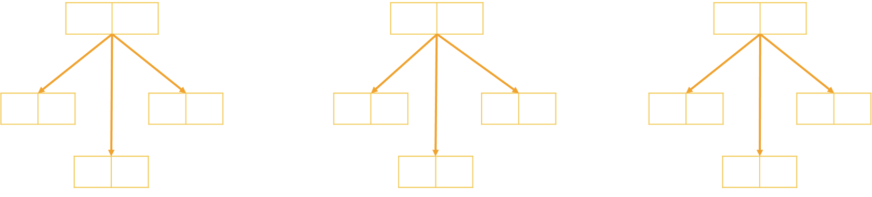
Problem: Generate Variations with Reps
Generates all possible variations of a given elements
You can pick an item multiple times
A A
A B
A C
B A B B
B C
C A
C B C C
A B C
2

Slide 57
Generating Permutations
public static void Gen(int index)
{
if (index >= k)
Console.WriteLine(string.Join(" ", variation));
else
{
for (int i = 0; i < n; i++)
{
variation[index] = elements[i];
Gen(index + 1);
}
}
elements = new int[n];
variation = new int[k]
Permute(0);

Slide 58
Variations with Reps: Iterative Algorithm
Generating the variations for n = 3 and k = 2
A | A
B | A
C | A
A | B
B | B
C | B
A | C
B | C
C | C

Slide 59
Variations with Reps: Iterative Algorithm
while (true)
{
Print(arr);
int index = k - 1;
while (index >= 0 && arr[index] == n-1)
index--;
if (index < 0)
break;
arr[index]++;
for (int i = index + 1; i < k; i++)
arr[i] = 0;
}
int n = 5;
int k = 3;
int[] arr = new int[k];
(0, 0, 0)
(0, 0, 1)
…
(4, 4, 2)
(4, 4, 3)
(4, 4, 4)

Slide 60

Variations Count
Order two from A, B, C and D in all possible ways
How many ways are there?
A | B | C | D
4
4
Multiply
$n$^{k} = $42$
16 different ways

Slide 61

Combinations

Slide 62





Combinations
Pick two to hang out

Slide 63
Combinations

Slide 64
Combinations

Slide 65
Combinations

Slide 66
Combinations

Slide 67
Combinations

Slide 68
Combinations

Slide 69
Combinations

Slide 70
Combinations

Slide 71
Combinations

Slide 72
Combinations

Slide 73
Combinations
Pick two form A, B and C
Order does not matter
A
B
C
A | B
A | C
B | C

Slide 74
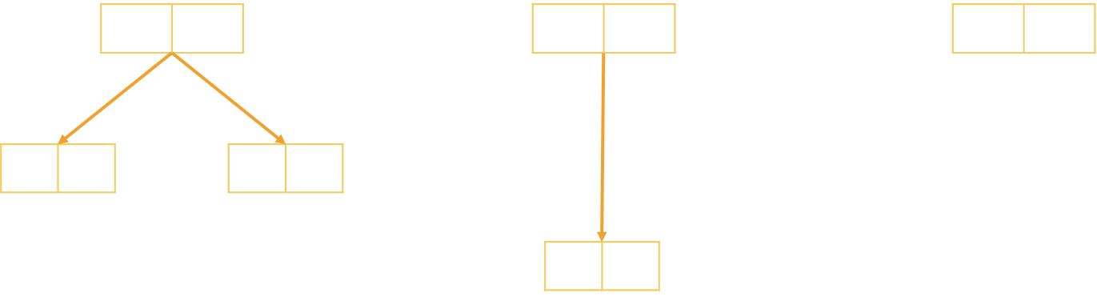
Problem: Generate Combinations
Generates all possible combinations from a given elements
You can pick each item only once
A B
A C
B C
A B C
2

Slide 75
Algorithm: Combinations without Repetition
Algorithm Comb(index, start)
Put the numbers i = start … n-1 at position index
Call Comb(index + 1, i + 1) to generate the rest of the array
Comb(0, start)
Comb(1, start)
Comb(k, start)
Print();
Stop!
i | x | x | x | x | x | x
→
y | i | x | x | x | x | x
…
Comb(1, i+1)
Comb(2, i+1)

Slide 76
Combinations without Repetition
void Comb(int index, int start)
{
if (index >= k)
{
PrintCombinations();
}
else
for (int i = start; i < n; i++)
{
arr[index] = i;
Comb(index + 1, i + 1);
}
}
int k = 3;
int n = 5;
int[] arr = new int[k];
Comb(0, 0);

Slide 77

Combinations Count
Pick two from A, B, C and D in all possible ways, order does not matter
How many ways are there?
A | B | C | D
4
3
Variations n = 4, k = 2
2
1
Permutations of n = 2
$\frac{n!}{k!\left(n−k\right)! }$ = $\frac{4!}{2!2!}$
6 different ways

Slide 78
Algorithm: Combinations with Repetition
Algorithm Comb(index, start)
Put the numbers i = start … n-1 at position index
Call Comb(index + 1, i) to generate the rest of the array
CombRep(0, start)
CombRep(1, start)
CombRep(k, start)
Print();
Stop!
i | x | x | x | x | x | x
→
y | i | x | x | x | x | x
…
CombRep(1, i)
CombRep(2, i)

Slide 79
Generate Combinations with Repetition
void Comb(int index, int start)
{
if (index >= k)
{
PrintCombinations();
}
else
for (int i = start; i < n; i++)
{
arr[index] = i;
Comb(index + 1, i);
}
}
int k = 3;
int n = 4;
int[] arr = new int[k];
Comb(0, 0);

Slide 80
Variations and Combinations
Live Exercises in Class (Lab)

Slide 81


N Choose K Count

Slide 82

Problem: Combinations Count
How many combinations are there for n = 16, k = 15
Solution:
How many ways to pick 15 items?
Divide by the number of ways in which you can arrange 15 numbers
Possible combinations → 16
$$C_{n}^{k}=\left({n \atop k}\right)=\frac{n!}{\left(n−k\right)!k!}$$
16 * 15 * 14 * … * 2
15 * 14 * 13 * … * 1

Slide 83
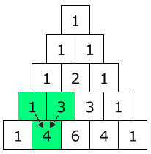

Pascal's Triangle
Each node → how many ways are there to reach it?
Quickly find N choose K count
Go down to row n (the top row is 0)
Move along k places to the right
The value there is your answer
$$C_{n}^{k}=\left({n \atop k}\right)=\frac{n!}{\left(n−k\right)!k!}$$

Slide 84
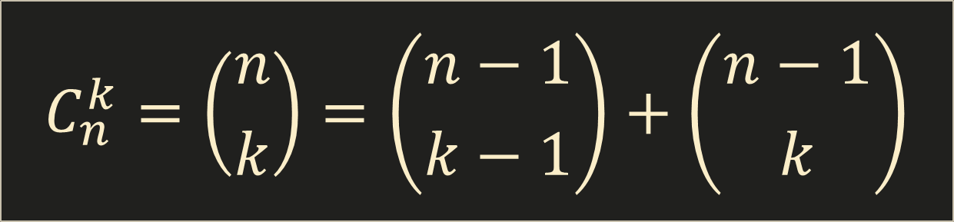
Binomial Coefficients: Calculation
$$C_{n}^{k}=\left({n \atop k}\right)=\left({n−1 \atop k−1}\right)+\left({n−1 \atop k}\right)$$
Base cases:
if k > n → 0
if k == 0 → 1
if k == n → 1

Slide 85

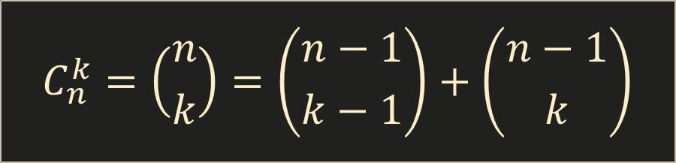
Binomial Coefficients: Calculation
decimal Binom(int n, int k)
{
if (k > n)
return 0;
if (k == 0 || k == n)
return 1;
return Binom(n - 1, k - 1) + Binom(n - 1, k);
}
$$C_{n}^{k}=\left({n \atop k}\right)=\left({n−1 \atop k−1}\right)+\left({n−1 \atop k}\right)$$
This is slow (stay tuned for DP)

Slide 86

Summary
Permutations – Ways to order n elements
Variations – Ways to order k of n elements
Combinations – Ways to choose k of n elements
Pascal's Triangle
Binomial Coefficients () – N choose K Count

Slide 87







Combinatorial Algorithms
https://softuni.bg/opencourses/algorithms

Slide 88
License
This course (slides, examples, labs, videos, homework, etc.) is licensed under the "Creative Commons Attribution-NonCommercial-ShareAlike 4.0 International" license
Attribution: this work may contain portions from
"Fundamentals of Computer Programming with C#" book by Svetlin Nakov & Co. under CC-BY-SA license
"Data Structures and Algorithms" course by Telerik Academy under CC-BY-NC-SA license

Slide 89





Trainings @ Software University (SoftUni)
Software University – High-Quality Education, Profession and Job for Software Developers
softuni.bg
Software University Foundation
softuni.org
Software University @ Facebook
facebook.com/SoftwareUniversity
Software University Forums
forum.softuni.bg

